Slide 1


Project Presentation on Let Segment Anything Help Image Dehaze
DEEP LEARNING
Names: XX
XX
XX
XX
Presented to: - Dr. Vinit Jakhetiya, Asst Professor

Slide 2
Overview
Introduction
What is SAM?
Proposed Model
Experiment
Results
Conclusion

Slide 3
Introduction
What is dehazing?
𝐼(𝑥) = 𝑅(𝑥)𝑡(𝑥) + 𝐿(𝑥)(1 − 𝑡(𝑥))
𝑡(𝑥) = 𝑒^(-𝛽⋅𝑑(𝑥))
Problem with existing Dehaze models
Benefits of large scale models - Emergent Self-Adaptive Ability
Notes:
𝐼(𝑥): This represents the signal received by a camera pixel at position 𝑥. In other words, it's the intensity or brightness of light captured by the camera at that specific location.
𝑅(𝑥): This is the signal emitted by the object at position 𝑥. It represents the intrinsic or original signal coming from the object without any atmospheric interference.
𝐿(𝑥): This term represents the atmospheric global illumination at position 𝑥. It accounts for the additional light that is scattered or reflected in the atmosphere and contributes to the observed signal.
𝑡(𝑥): This is the transmission rate, and it quantifies the proportion of light that reaches the camera sensor after traveling through the atmosphere and interacting with the object. It essentially tells us how much of the original signal 𝑅(𝑥) survives the journey to the camera.
The transmission rate 𝑡(𝑥) is calculated using another equation:
𝑡(𝑥) = 𝑒^(-𝛽⋅𝑑(𝑥)): This equation describes how the transmission rate 𝑡(𝑥) decreases exponentially with the distance 𝑑(𝑥) from the object to the camera. 𝛽 represents the attenuation coefficient, which controls how quickly the signal attenuates with distance. The use of the exponential function indicates that attenuation follows an exponential decay pattern.
low-level computer vision tasks, such as image dehazing and blur removal face limitations due to the scarcity of datasets and the use of small-sized models. This often results in overfitting (models learning to perform well on the training data but not generalizing well to new data) and getting stuck in local optima (suboptimal solutions).
Emergent Self-Adaptive Ability of Large-Scale Image Segmentation Models: The passage begins by highlighting an interesting finding - that large-scale image segmentation models have the ability to adapt to and perform well in foggy conditions, even when they were not explicitly trained on foggy images. This adaptability emerges as a result of increasing the network's parameters or complexity.

Slide 4
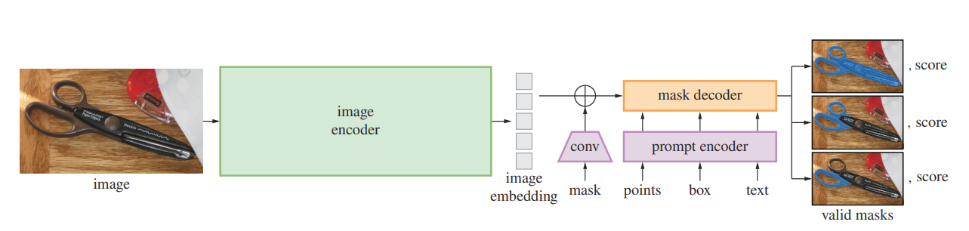
What is SAM?

Slide 5
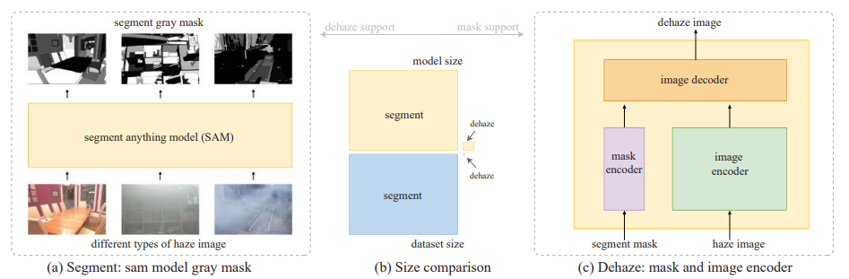
Proposed Model
Grayscale Coding and Channel Expansion
Notes:
The proposed framework suggests integrating knowledge from large models into these low-level tasks to enhance their performance. The framework draws a parallel between image segmentation and dehazing, suggesting that, similar to image segmentation, the degradation caused by haze in images is related to texture. This insight is critical in designing the proposed framework.
Grayscale Coding and Channel Expansion: The authors introduce a new framework that involves techniques such as grayscale coding and channel expansion. These techniques are designed to facilitate the transfer of the large model's advantages to smaller, low-level visual dehazing models. In other words, they help small dehazing networks acquire the dehazing capabilities of the large segmentation models framework that uses techniques like grayscale coding and channel expansion to transfer the advantages of large models to low-level visual dehazing tasks, even when working with smaller-scale data and models.
Segmentation Results: In the context of image segmentation, a segmentation model is used to classify each pixel in an image into different segments or categories. Each pixel is assigned a label or a digital number that corresponds to the segment it belongs to. These labels indicate which part of the image corresponds to which object or category.
Visualization of Segmentation Results: Typically, in image segmentation projects, the segmentation results are visualized by converting them to color images. This means that different colors are assigned to different segments or categories in the image. Each segment is displayed in a distinct color, making it easier to visually distinguish between segments.
Color Visualization Complexity: While visualizing segmentation results in color can be helpful for human interpretation, it has some drawbacks. Color images typically have three channels (red, green, and blue), each representing a different color component. This means that when converting segmentation results to color, it requires three channels to represent the information, which can increase the computational complexity of subsequent models used for dehazing.
Grayscale Channel: To address the computational complexity issue, the proposed technique suggests combining the segmentation information into a grayscale channel instead of using color channels. Grayscale images have only one channel and represent pixel intensity without color information. By encoding segmentation results into a grayscale channel, the computational demands of subsequent models, such as those used for dehazing, can be reduced.
Grayscale Space: Grayscale coding aims to fill the 1-255 grayscale space (with 0 representing no segmentation) to represent different segmentation results. In this context, grayscale values range from dark (e.g., 1) to bright (e.g., 255). This gradation in grayscale values allows for a clear representation of the output order of each segmentation result.
Order of Segmentation Results: The grayscale coding method orders segmentation results based on their brightness. In this scheme, brighter areas in the segmentation results of the same image indicate a more effective or better segmentation. This means that the network's performance is considered better when the corresponding segment is represented by a brighter grayscale value.
Subjective Understanding: Grayscale coding provides a way to subjectively assess and understand the segmentation effect. By visually inspecting the grayscale-coded segmentation results, one can intuitively gauge the quality of the segmentation. Brighter areas indicate more precise and clear segmentations, making it easier for users to assess how well the segmentation model is performing

Slide 6
Proposed Model
Segment Model
Size Comparison
Image Domain Translation Ability
Interaction between Models
Notes:
Segment Model: In this step (labeled as "a"), a haze image is input into a large-scale segmentation model. The primary goal of this model is to segment the image, which means identifying different regions or objects within the image. Instead of providing a colored segmentation result, it outputs a segmentation result in grayscale encoding. This grayscale encoding represents the segmented regions in varying shades of gray.
Size Comparison: There is a significant difference in scale between the largest existing dehazing models and the large-scale segmentation models. Both in terms of the size of the neural network (network size) and the amount of data used for training (dataset size), these two types of models differ by several orders of magnitude. This size difference is crucial to understanding how they can complement each other.
Emergence Capability of Large Models: Large-scale segmentation models have the ability to adapt to handle haze images, even if they have not been explicitly trained on such images. This adaptability is referred to as the "emergence capability" of large models, meaning they can handle tasks that were not originally part of their training data.
Image Domain Translation Ability: Dehazing models have the ability to "dehaze" images, removing the effects of haze or fog. This process is achieved through the "Dehaze" step, which is not described in detail in the provided passage.
Interaction between Models: The emergence transparency ability of large-scale segmentation models and the image domain translation ability of dehazing models can complement each other. Specifically, the grayscale-encoded segmentation mask, produced by the segmentation model, is added to the encoder part of the image dehazing network. This integration appears to help the dehazing network better understand the regions that need dehazing by providing additional information from the segmentation result.
In summary, this is a framework for improving image dehazing by combining the capabilities of large-scale segmentation models (which can adapt to haze images) and image dehazing models. The grayscale-encoded segmentation masks are used to guide the dehazing process by highlighting regions of interest. The key advantage here is the synergy between the large model's adaptability and the dehazing model's haze removal capabilities, despite their significant differences in scale.

Slide 7
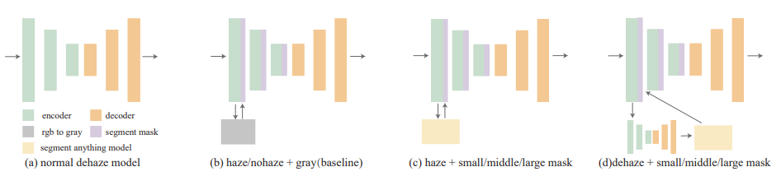
Experiments

Slide 8
Experiments
Parameter Increase and Unfair Comparison
Baseline: Grayscale Images
Types of Dehazing Network Experiments
Haze Gray
Nohaze Gray
Haze + Small/Middle/Large
Nohaze + Small/Middle/Large
Dehaze + Small/Middle/Large
Notes:
this methodology aims for evaluating and comparing different dehazing network structures. It involves the use of grayscale images, different model sizes, and various types of masks. Here's an explanation of the key elements and objectives in this methodology:
Parameter Increase and Unfair Comparison:
Increasing the number of channels in dehazing networks can lead to a significant increase in parameters.
This parameter change can make it unfair to directly compare the original network structure with an improved one because they have different parameter counts.
To address this issue and make comparisons fair, the methodology introduces a baseline approach using grayscale images.
Baseline: Grayscale Images:
Grayscale images are generated from the RGB channels of the original images.
These grayscale images are introduced as the baseline, serving as a reference point for evaluating the impact of parameter changes.
Since haze concentration and distribution vary across different datasets, this baseline also helps assess the difficulty of the datasets themselves.
Types of Dehazing Network Structures:
The methodology proceeds to test different types of dehazing network structures using the grayscale images as masks. These structures are evaluated in the context of various model sizes and masks.
Types of Dehazing Network Experiments:
Several types of experiments are conducted:
Haze Gray: The grayscale of the haze image is directly sent to the network as a segmentation mask (segmask).
Nohaze Gray: The grayscale image of the fog-free image (no haze) is directly sent as a segmask. This represents an ideal case for evaluation.
Haze + Small/Middle/Large: After segmenting the hazy image using different-sized models (small, middle, large), the segmentation result is sent to the network as a segmask.
Nohaze + Small/Middle/Large: After segmenting the no-haze image using different-sized models, the segmentation result is sent as a segmask. This is used to evaluate the performance of the segmentation network and for dehazing training.
Dehaze + Small/Middle/Large: The dehazing process is applied first, and the resulting dehazed image is segmented using different-sized models. The segmentation result is then sent to the network as a segmask. This is used in actual dehazing tests.
In summary, this methodology involves a series of experiments with different types of masks and network structures to evaluate dehazing performance. Grayscale images are used as a baseline to account for parameter changes and dataset variations. The experiments aim to assess the capabilities of dehazing networks and the performance of segmentation models in different scenarios and under various conditions.

Slide 9
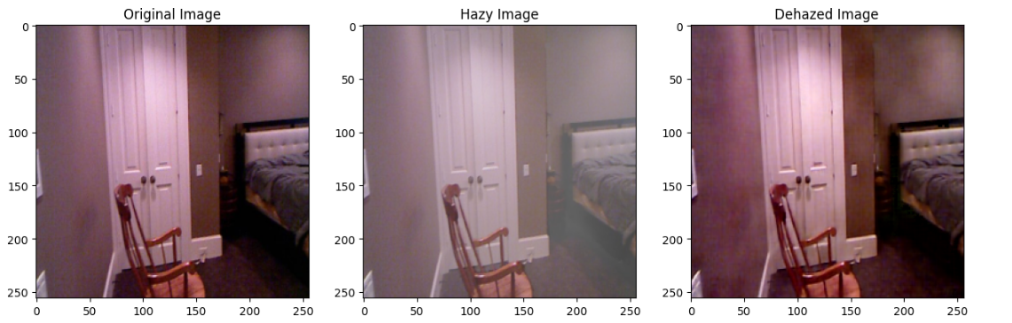
Results
Without Mask

Slide 10
Results
With Gray Mask

Slide 11
Results
With SAM Mask

Slide 12
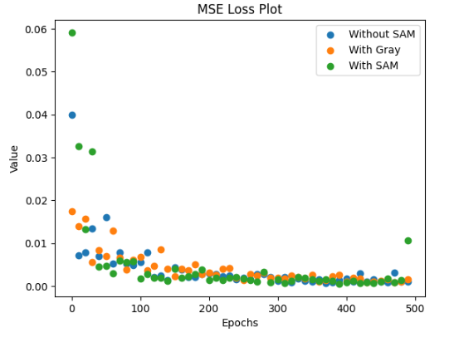
Results
MSE LOSS PLOT

Slide 13
Thank you!

